Slide 1
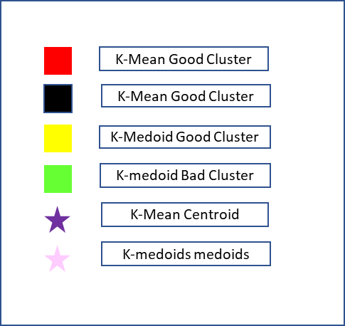
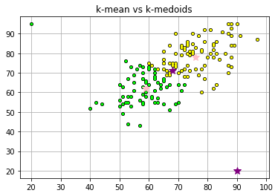


12th_result
K-Mean Good Cluster
K-Mean Good Cluster
K-Medoid Good Cluster
K-medoid Bad Cluster
K-Mean Centroid
1st year
K-medoids medoids

Slide 2
